Slide 1
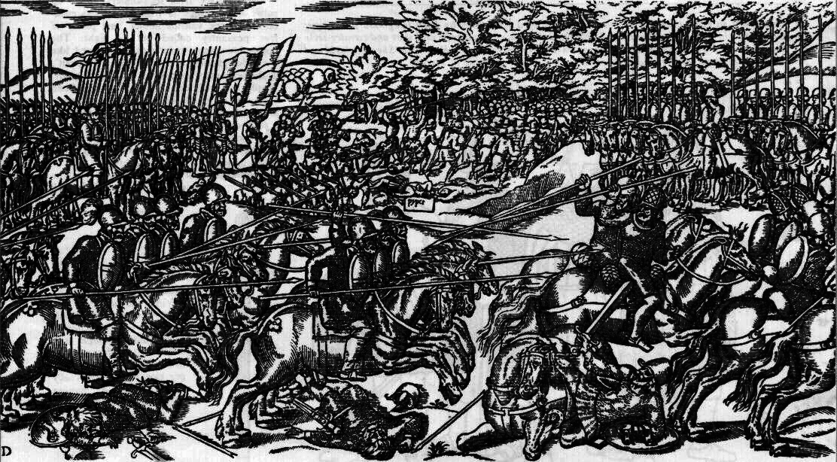
Elizabethan Era
Military
BY Skye Yang Period 7

Slide 2
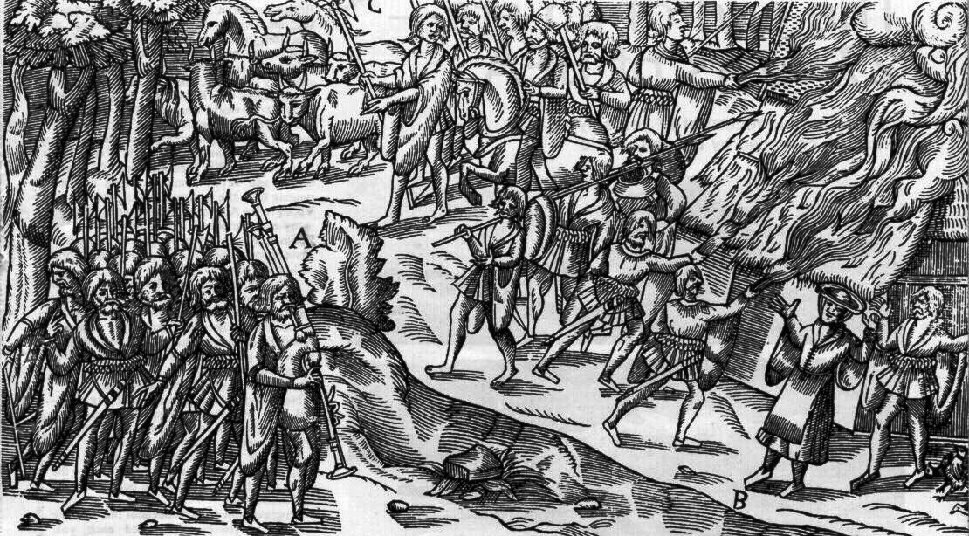
Sources/Sites
https://www.tudorgroup.co.uk/?p=373#:~:text=Within%20the%20Elizabethan%20military%20structure,and%20Wiffler%20were%20still%20in
http://elizabethanenglandlife.com/different-kinds-of-elizabethan-era-weapons.html#Popular_Elizabethan_Weapons_from_Medieval_Times

Slide 3
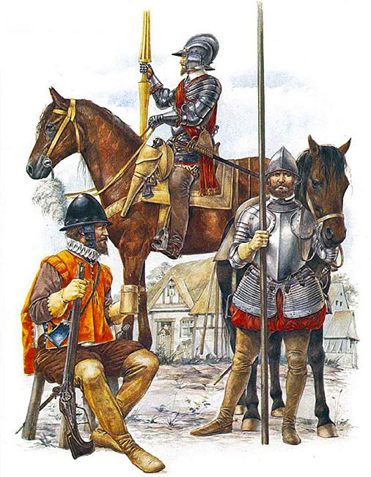
Military Ranks
The ranking follows best to weakest, Colonel General to Lieutenant General to Sergeant Major General to Colonel to Captain to Lieutenant to Sergeant Major to Ensigne to Sergeant to Corporal.
The weakest to the best of the army

Slide 4
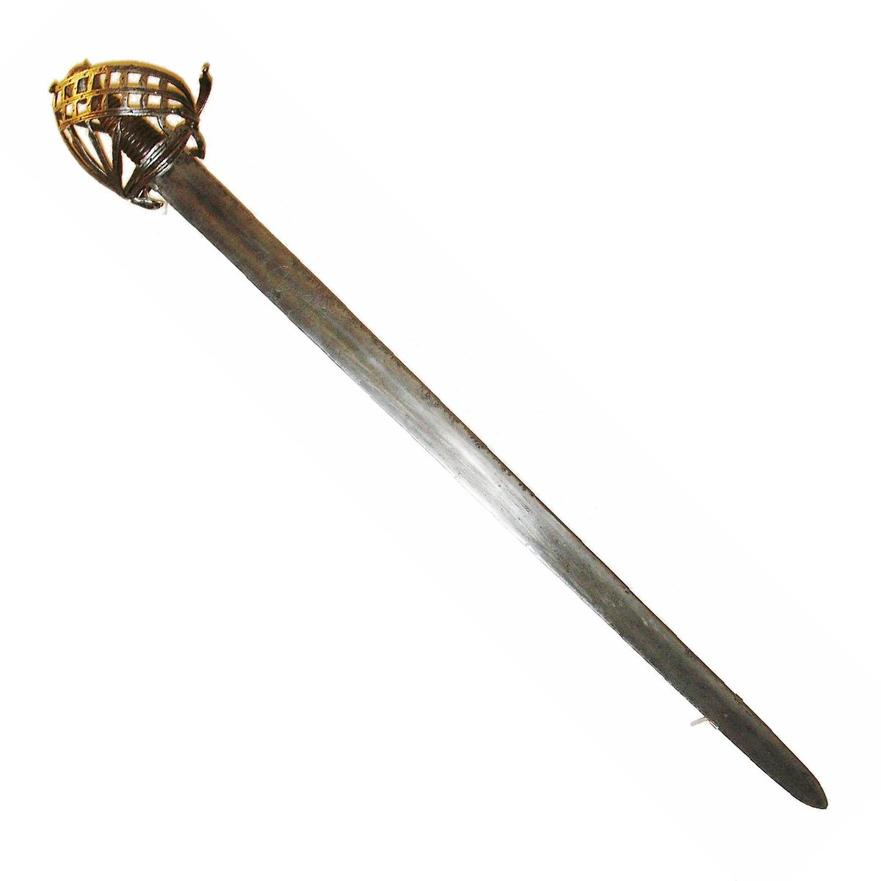
Training Weapons
Soldiers used these close range weapons as training items in fencing. The most favorite one was the rapier.
Broadswords, Cutting Swords, and Rapiers

Slide 5
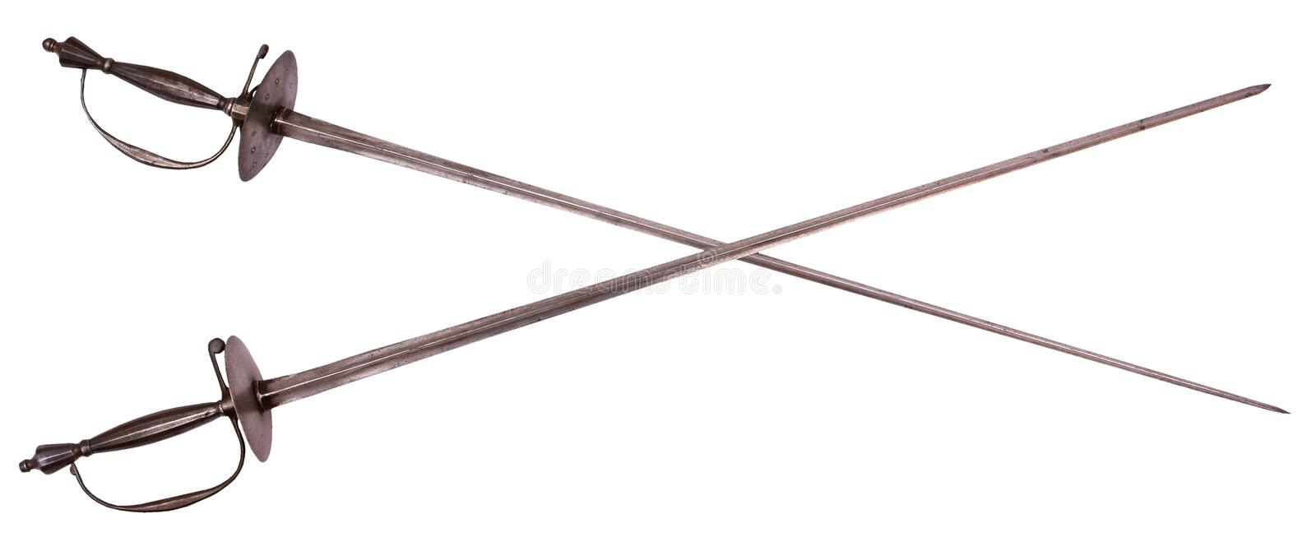
Rapiers
Even though the blade is wide and the sides aren't sharp but the point was a sharp killer with its 30 to 72 inches size, attacking with quick thrusting and cutting attacks being the most deadliest weapon of them all.
The favorite weapon

Slide 6
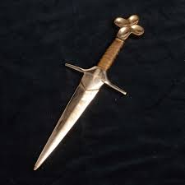
Daggers
They were very short blades and were used to pierce, thrust, and stab weapons. They were the secondary weapon of the army
The small weapon

Slide 7
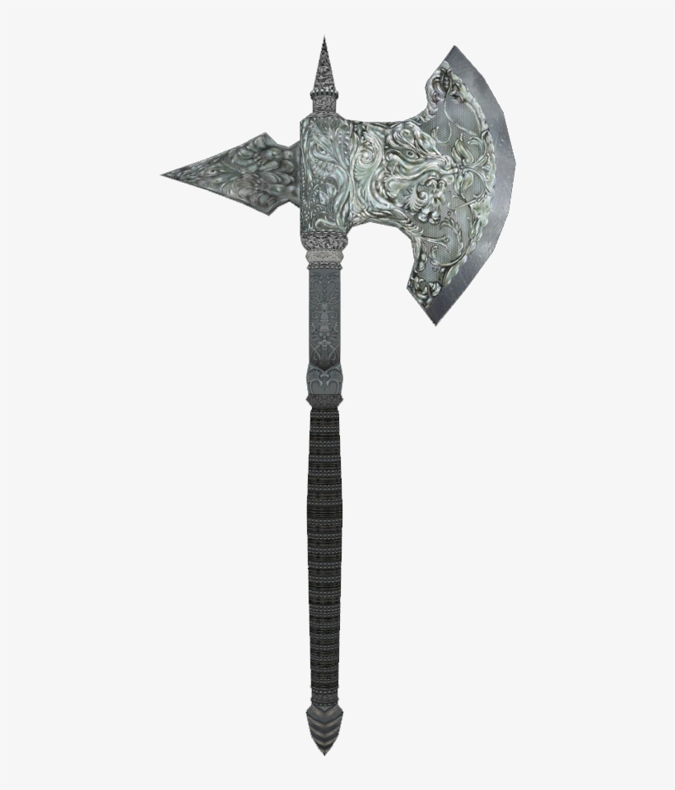
Battle Axe
Foot Soldiers use this weapon for close combat because it was extremely effect by having low precision.
Battle weapon

Slide 8
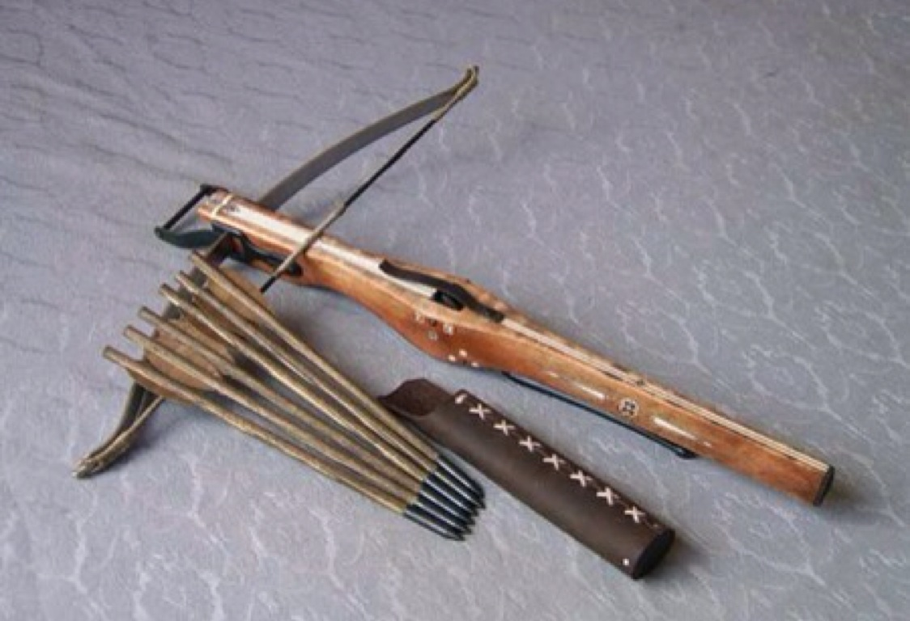
Long Ranged weapons
Bows and arrows were highly effective on long ranges by how easy to use and arrows having sharp ends and going far when shot. Crossbows were not as easy to use and had a long reload time however had a higher range.
Bows and Arrows and Crossbows

Slide 9
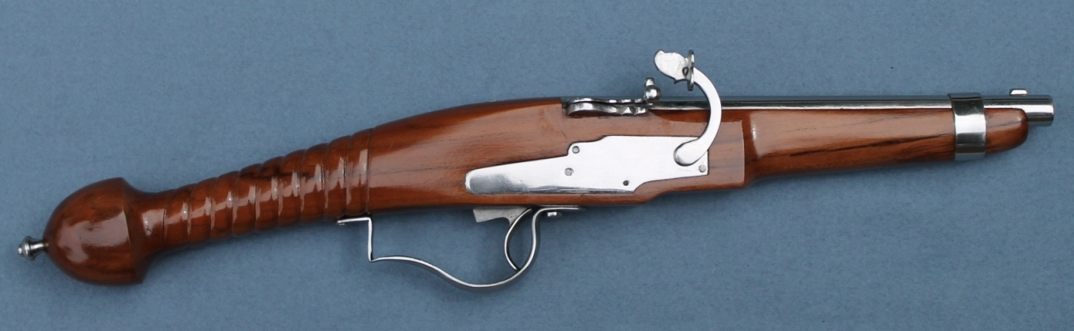
Musket
It had two versions, first having terrible accurately and a long reload time, second being improved by having flintlocks but both were used as long ranged weapons.
THE GUN (fire arms)

Slide 10
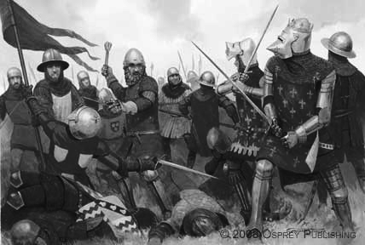
THE END
I HOPE YOU ENJOY
BY SKYE YANG PERIOD 7

